Slide 1








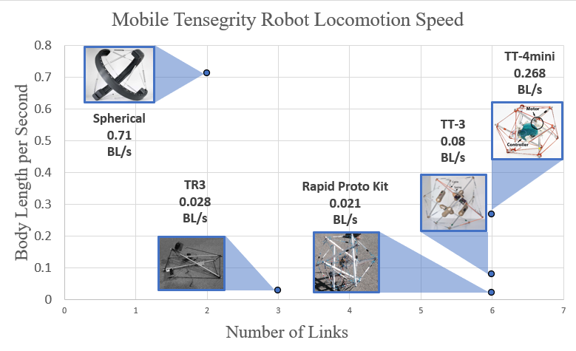
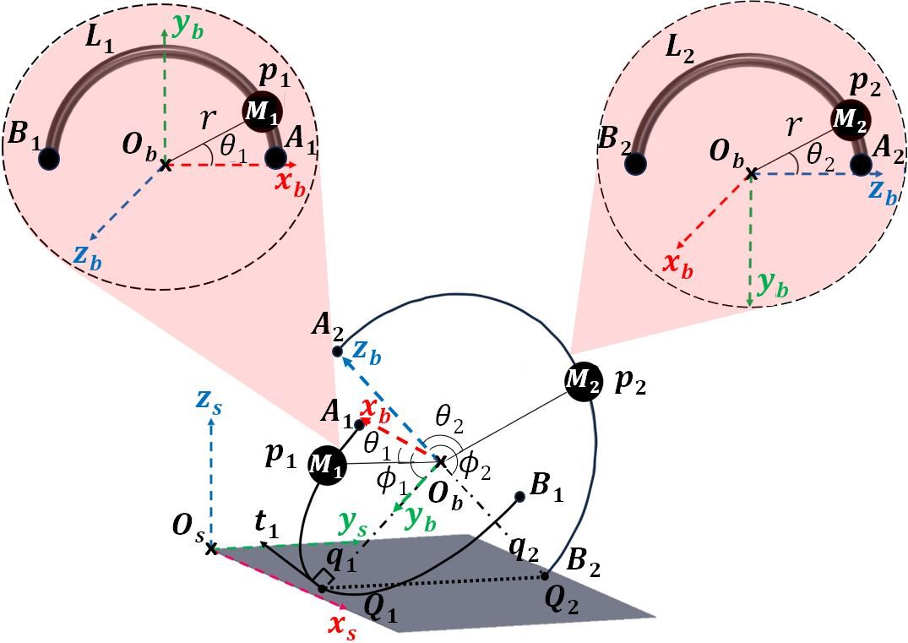
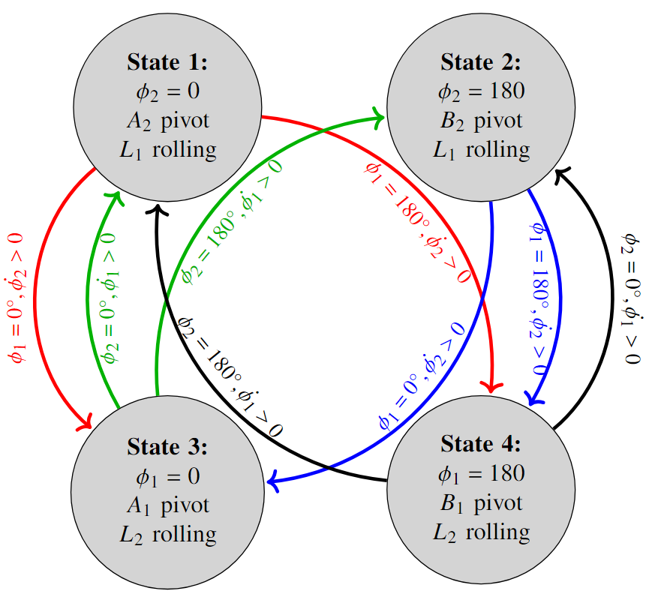
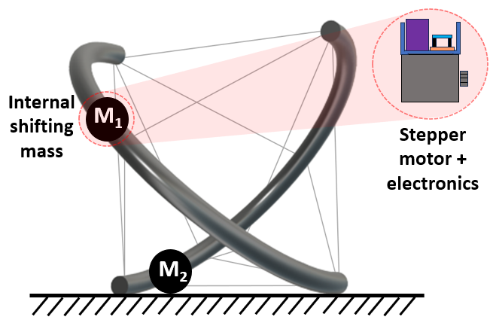

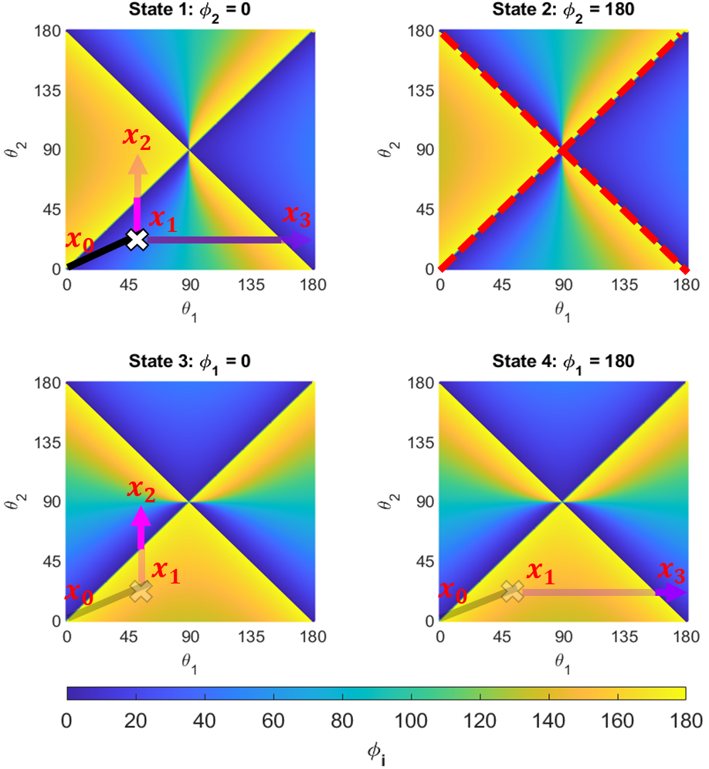
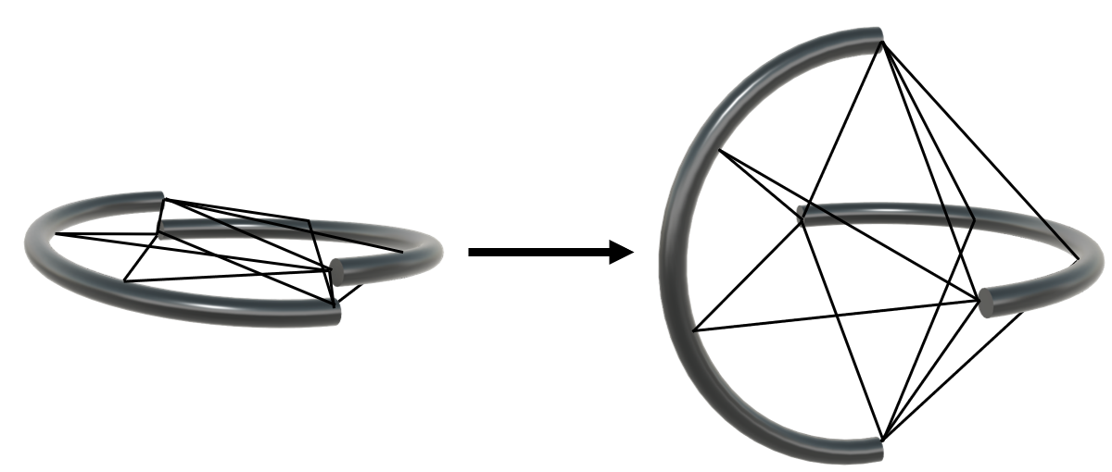
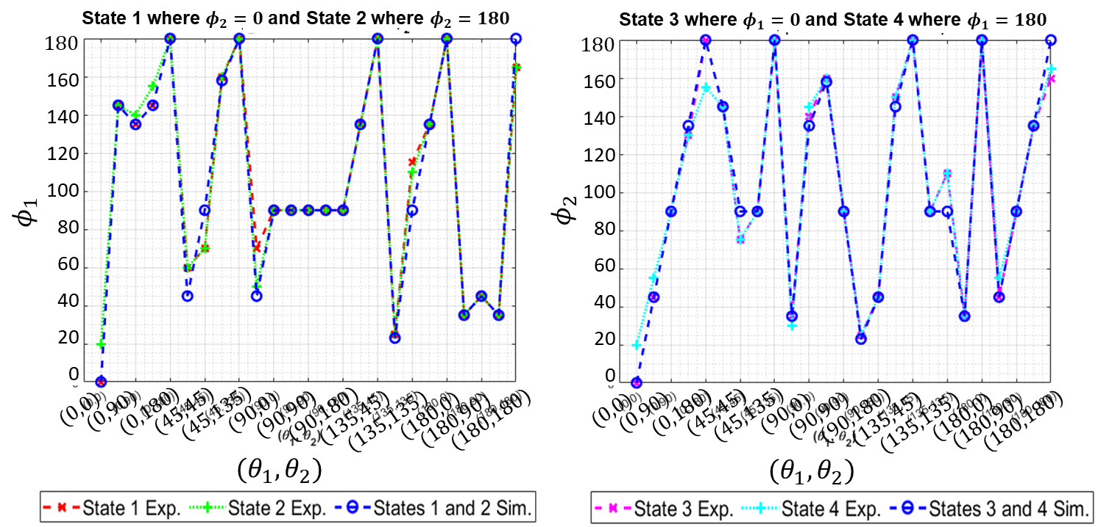
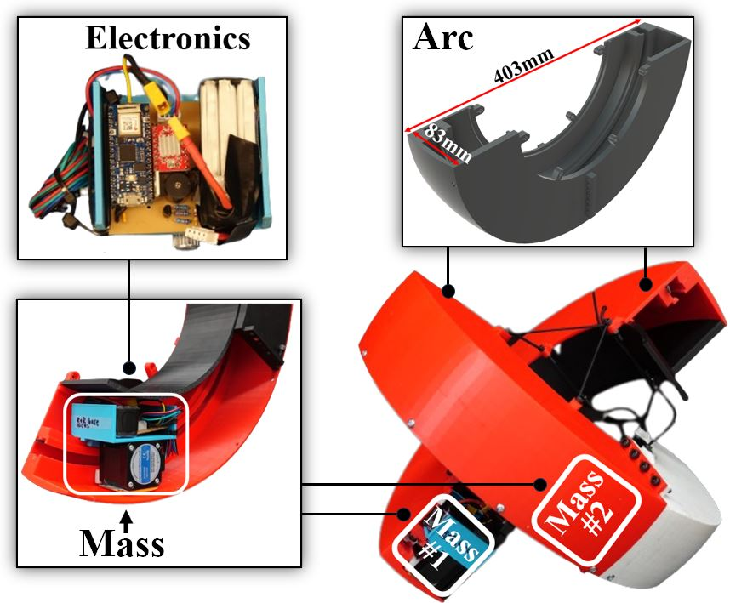
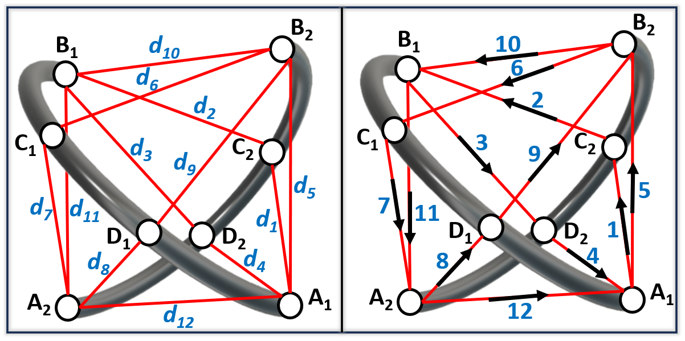


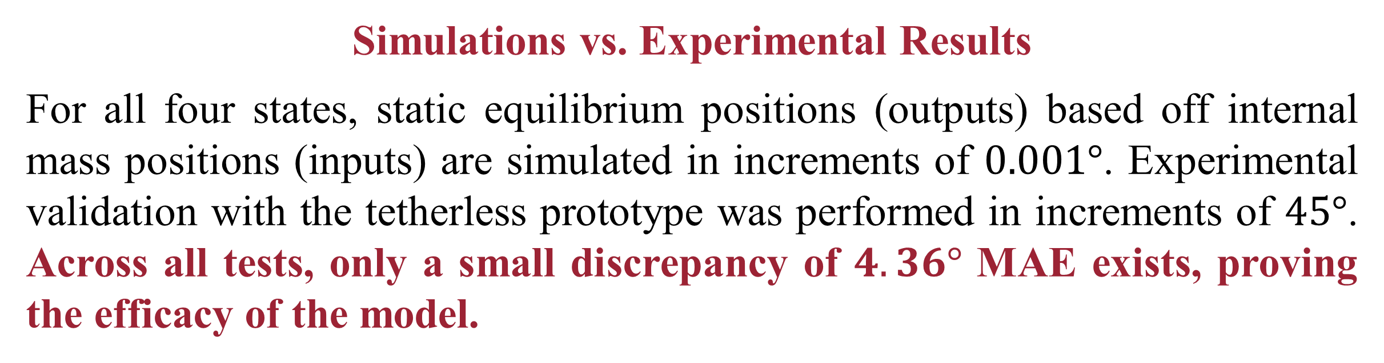
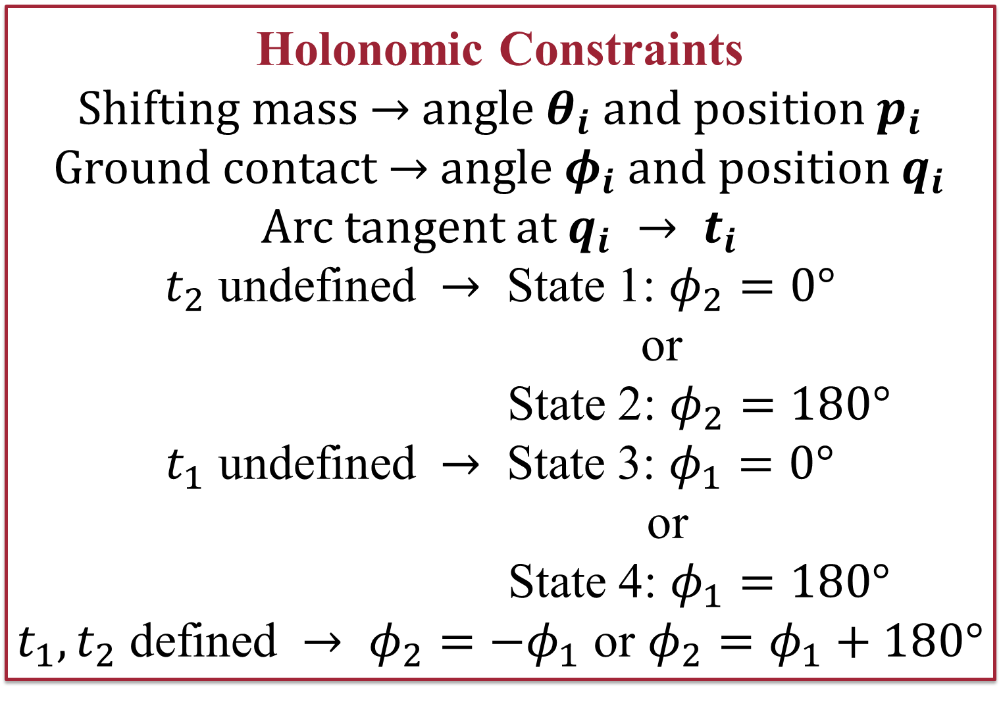
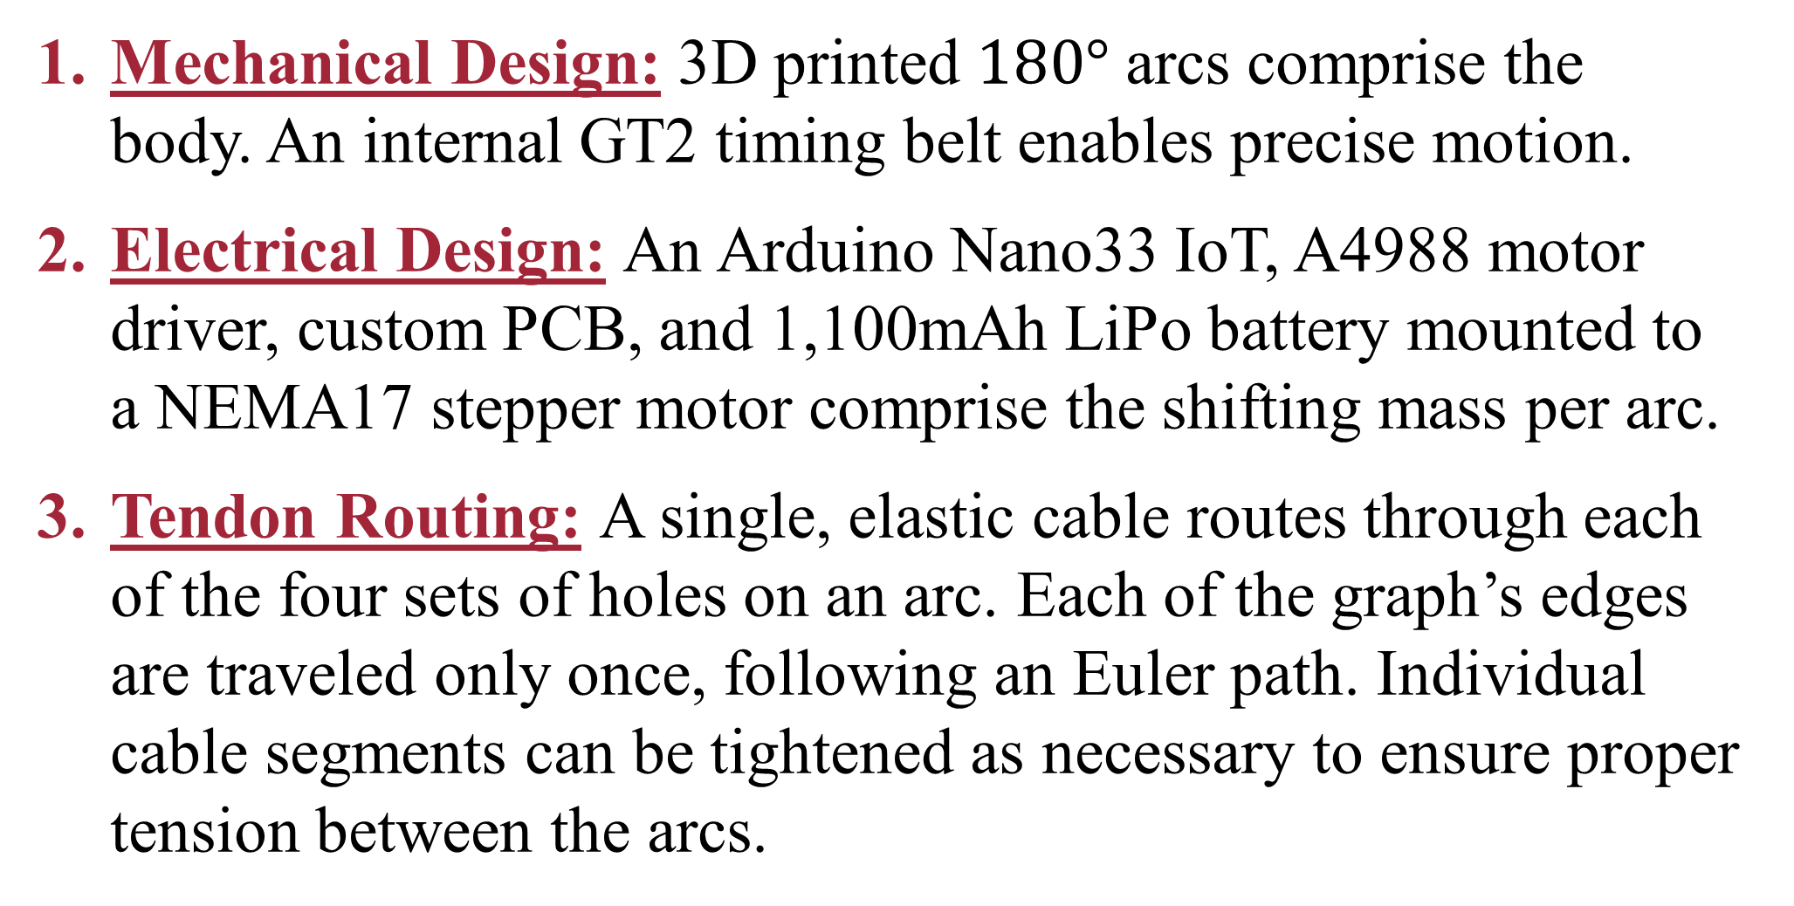
Geometric Static Modeling Framework for Piecewise-Continuous Curved-Link Multi Point-of-Contact Tensegrity Robots
Lauren Ervin and Vishesh Vikas
Agile Robotics Lab, The University of Alabama
Introduction and Motivation
Hybrid System and Static Modeling
A tensegrity structure is comprised of rigid struts under compression with prestressed members held in tension to achieve structural integrity. Tensegrity structures are lightweight, packable, impact resistant, and internally stable making them ideal candidates for locomotion in unstructured environments such as search and rescue and space scenarios. A
TeXploR poses the following modeling challenges:
Discontinuous nature of the curved links requiring state switching.
Constantly changing ground contact points.
Instantaneous movement of the masses along the links.​
TeXploR rolls by shifting an internal mass along each arc, instantaneously changing the robot’s CoM.
Four-State Hybrid System
The use of Lie groups and Screw Theory provides an analytical solution with ease of transforming c.s.​ This results in a closed form solution dependent on the hybrid system state. One internal mass always acts as the pivot while the other traverses its arc, resulting in a piecewise continuous trajectory with four traversal states.
2CL
Fig. 1: Tensegrity Robot Locomotion Speed [1-5]
Fig. 3: TeXploR Geometric Representation
speed comparison of recent tensegrity robots, Fig. 1, shows the increased efficiency in spherical link designs. The reality gap – movement in a non-lab setting – remains an unsolved problem from the perspective of mobility, controls, and design.
Contributions: The curved-link TeXploR (Tensegrity eXploratory Robot) [6] has
Geometric Framework that statically models the multi point-of-contact system.
Adaptability to robots with multiple points of contact/different morphologies.
Four-State Hybrid System where each state corresponds to TeXploR instantaneously pivoting about the end of one link while rolling along the other.
Input-Output Relationship between internal mass positions and contact points (robot orientation). A tetherless prototype experimentally validates the model.
Holonomic Constraints
Shifting mass $→$ angle $θ_{i}$and position $p_{i}$
Ground contact $→$angle $φ_{i}$and position $q_{i}$
Arc tangent at $q_{i} → t_{i}$
$t_{2}$ undefined $→$ State 1: $φ_{2}=0°$
or
State 2: $φ_{2}=180°$
$t_{1}$ undefined $→$ State 3: $φ_{1}=0°$
or
State 4: $φ_{1}=180°$
$t_{1}, t_{2}$ defined $→$ $φ_{2}=−φ_{1}$ or $φ_{2}=φ_{1}+180°$
Fig. 2: Internal Shifting Mechanism
Fig. 4: Hybrid State System
Design, Mechatronics, and Fabrication
Static Simulations and Experimental Validation
Future Works
Mechanical Design: 3D printed $180°$ arcs comprise the body. An internal GT2 timing belt enables precise motion.
Electrical Design: An Arduino Nano33 IoT, A4988 motor driver, custom PCB, and 1,100mAh LiPo battery mounted to a NEMA17 stepper motor comprise the shifting mass per arc.
Tendon Routing: A single, elastic cable routes through each of the four sets of holes on an arc. Each of the graph’s edges are traveled only once, following an Euler path. Individual cable segments can be tightened as necessary to ensure proper tension between the arcs.
Simulations vs. Experimental Results
For all four states, static equilibrium positions (outputs) based off internal mass positions (inputs) are simulated in increments of $0.001°$. Experimental validation with the tetherless prototype was performed in increments of $45°$. Across all tests, only a small discrepancy of $4.36°$ MAE exists, proving the efficacy of the model.
State Jumping
Switching states can occur anywhere along the border lines for gaits more complicated than straight rolling.
Active shape morphing visualized in Fig. 7
Complex movements - jumping and slipping
Dynamic modeling
Fig. 7: Shape Reconfiguration
References
Chen, L.-H., Cera, B., Zhu, E. L., Edmunds, R., Rice, F., Bronars, A., Tang, E., Malekshahi, S. R., Romero, O., Agogino, A. K.; Agogino, A. M. (2017). Inclined surface locomotion strategies for spherical Tensegrity Robots. 2017 IEEE/RSJ International Conference on Intelligent Robots and Systems (IROS). https://doi.org/10.1109/iros.2017.8206380
Bohm, V., Kaufhold, T., Schale, F., & Zimmermann, K. (2016). Spherical mobile robot based on a tensegrity structure with curved compressed members. IEEE/ASME International Conference on Advanced Intelligent Mechatronics, AIM, 2016-09,1509–1514. https://doi.org/10.1109/AIM.2016.7576984
Paul, C., Valero-Cuevas, F. J., &amp; Lipson, H. (2006). Design and control of Tensegrity robots for Locomotion. IEEE Transactions on Robotics, 22(5), 944–957. https://doi.org/10.1109/tro.2006.878980
Chen, L., Kim, K., Tang, E., Li, K., House, R., Zhu, E. L., Fountain, K., Agogino, A. M., Agogino, A., Sunspiral, V., and Jung, E. (March 9, 2017). "Soft Spherical Tensegrity Robot Design Using Rod-Centered Actuation and Control." ASME. J. Mechanisms Robotics. April 2017; 9(2): 025001. https://doi.org/10.1115/1.4036014
K. Kim et al., "Rapid prototyping design and control of tensegrity soft robot for locomotion," 2014 IEEE International Conference on Robotics and Biomimetics (ROBIO 2014), Bali, Indonesia, 2014, pp. 7-14, doi: 10.1109/ROBIO.2014.7090299.
L. Ervin and V. Vikas, "Geometric Static Modeling Framework for Piecewise-Continuous Curved-Link Multi Point-of-Contact Tensegrity Robots," in IEEE Robotics and Automation Letters, vol. 9, no. 12, pp. 11066-11073, Dec. 2024, doi: 10.1109/LRA.2024.3486199.
Fig. 5: Cable Routing Assembly
Fig. 6: TeXploR Fabrication
This work is supported in part by NASA grant #80NSSC20M0044 awarded to the Alabama Space Grant Consortium.

Slide 2
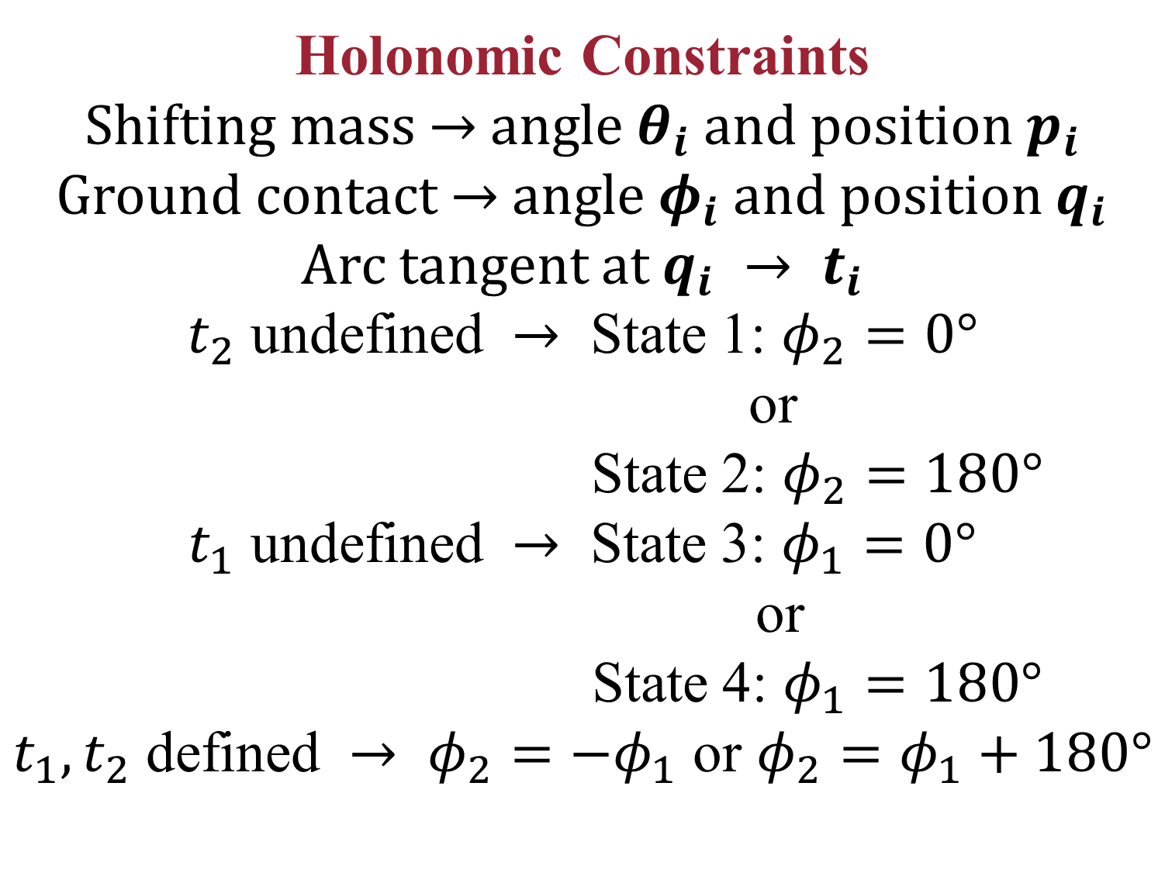
Geometric Static Modeling Framework for Piecewise-Continuous Curved-Link Multi Point-of-Contact Tensegrity Robots
Lauren Ervin and Vishesh Vikas
Agile Robotics Lab, The University of Alabama
Introduction and Motivation
Hybrid System and Static Modeling
A tensegrity structure is comprised of rigid struts under compression with prestressed members held in tension to achieve structural integrity. Tensegrity structures are lightweight, packable, impact resistant, and internally stable making them ideal candidates for locomotion in unstructured environments such as search and rescue and space scenarios. A
TeXploR poses the following modeling challenges:
Discontinuous nature of the curved links requiring state switching.
Constantly changing ground contact points.
Instantaneous movement of the masses along the links.​
TeXploR rolls by shifting an internal mass along each arc, instantaneously changing the robot’s CoM.
Four-State Hybrid System
The use of Lie groups and Screw Theory provides an analytical solution with ease of transforming c.s.​ This results in a closed form solution dependent on the hybrid system state. One internal mass always acts as the pivot while the other traverses its arc, resulting in a piecewise continuous trajectory with four traversal states.
2CL
Fig. 1: Tensegrity Robot Locomotion Speed [1-5]
Fig. 3: TeXploR Geometric Representation
speed comparison of recent tensegrity robots, Fig. 1, shows the increased efficiency in spherical link designs. The reality gap – movement in a non-lab setting – remains an unsolved problem from the perspective of mobility, controls, and design.
Contributions: The curved-link TeXploR (Tensegrity eXploratory Robot) [6] has
Geometric Framework that statically models the multi point-of-contact system.
Adaptability to robots with multiple points of contact/different morphologies.
Four-State Hybrid System where each state corresponds to TeXploR instantaneously pivoting about the end of one link while rolling along the other.
Input-Output Relationship between internal mass positions and contact points (robot orientation). A tetherless prototype experimentally validates the model.
Holonomic Constraints
Shifting mass $→$ angle $θ_{i}$and position $p_{i}$
Ground contact $→$angle $φ_{i}$and position $q_{i}$
Arc tangent at $q_{i} → t_{i}$
$t_{2}$ undefined $→$ State 1: $φ_{2}=0°$
or
State 2: $φ_{2}=180°$
$t_{1}$ undefined $→$ State 3: $φ_{1}=0°$
or
State 4: $φ_{1}=180°$
$t_{1}, t_{2}$ defined $→$ $φ_{2}=−φ_{1}$ or $φ_{2}=φ_{1}+180°$
Fig. 2: Internal Shifting Mechanism
Fig. 4: Hybrid State System
Design, Mechatronics, and Fabrication
Static Simulations and Experimental Validation
Future Works
Mechanical Design: 3D printed $180°$ arcs comprise the body. An internal GT2 timing belt enables precise motion.
Electrical Design: An Arduino Nano33 IoT, A4988 motor driver, custom PCB, and 1,100mAh LiPo battery mounted to a NEMA17 stepper motor comprise the shifting mass per arc.
Tendon Routing: A single, elastic cable routes through each of the four sets of holes on an arc. Each of the graph’s edges are traveled only once, following an Euler path. Individual cable segments can be tightened as necessary to ensure proper tension between the arcs.
Simulations vs. Experimental Results
For all four states, static equilibrium positions (outputs) based off internal mass positions (inputs) are simulated in increments of $0.001°$. Experimental validation with the tetherless prototype was performed in increments of $45°$. Across all tests, only a small discrepancy of $4.36°$ MAE exists, proving the efficacy of the model.
State Jumping
Switching states can occur anywhere along the border lines for gaits more complicated than straight rolling.
Active shape morphing visualized in Fig. 7
Complex movements - jumping and slipping
Dynamic modeling
Fig. 7: Shape Reconfiguration
References
Chen, L.-H., Cera, B., Zhu, E. L., Edmunds, R., Rice, F., Bronars, A., Tang, E., Malekshahi, S. R., Romero, O., Agogino, A. K.; Agogino, A. M. (2017). Inclined surface locomotion strategies for spherical Tensegrity Robots. 2017 IEEE/RSJ International Conference on Intelligent Robots and Systems (IROS). https://doi.org/10.1109/iros.2017.8206380
Bohm, V., Kaufhold, T., Schale, F., & Zimmermann, K. (2016). Spherical mobile robot based on a tensegrity structure with curved compressed members. IEEE/ASME International Conference on Advanced Intelligent Mechatronics, AIM, 2016-09,1509–1514. https://doi.org/10.1109/AIM.2016.7576984
Paul, C., Valero-Cuevas, F. J., &amp; Lipson, H. (2006). Design and control of Tensegrity robots for Locomotion. IEEE Transactions on Robotics, 22(5), 944–957. https://doi.org/10.1109/tro.2006.878980
Chen, L., Kim, K., Tang, E., Li, K., House, R., Zhu, E. L., Fountain, K., Agogino, A. M., Agogino, A., Sunspiral, V., and Jung, E. (March 9, 2017). "Soft Spherical Tensegrity Robot Design Using Rod-Centered Actuation and Control." ASME. J. Mechanisms Robotics. April 2017; 9(2): 025001. https://doi.org/10.1115/1.4036014
K. Kim et al., "Rapid prototyping design and control of tensegrity soft robot for locomotion," 2014 IEEE International Conference on Robotics and Biomimetics (ROBIO 2014), Bali, Indonesia, 2014, pp. 7-14, doi: 10.1109/ROBIO.2014.7090299.
L. Ervin and V. Vikas, "Geometric Static Modeling Framework for Piecewise-Continuous Curved-Link Multi Point-of-Contact Tensegrity Robots," in IEEE Robotics and Automation Letters, vol. 9, no. 12, pp. 11066-11073, Dec. 2024, doi: 10.1109/LRA.2024.3486199.
Fig. 5: Cable Routing Assembly
Fig. 6: TeXploR Fabrication
This work is supported in part by NASA grant #80NSSC20M0044 awarded to the Alabama Space Grant Consortium.

